Slide 1


TELEMEDICINE MANAGMENT SYSTEM
Hospital Care Reimagined.
Virtual Capabilities to Enhance Care.
www.thegemini.co.in

Slide 2
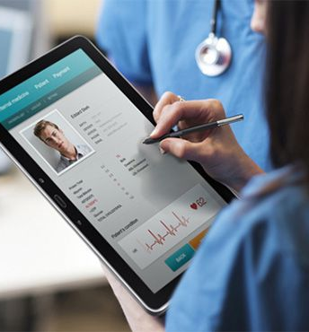
INTRODUCTION
Leveraging the latest in digital technology, The Gemini Telemedicine management System is a customizable solution incorporating virtual consultation and coordination services to help you provide safe, high quality TeleHealth to everyone
Every one deserves equal access to healthcare. Whether someone lives in a remote area or simply doesn’t have the capacity to visit a clinician, The Gemini can help fill your healthcare gaps with a TeleHealth program tailored to your needs.
We can help you to coordinate and connect your patients with doctors, specialists and allied health professionals via our Telemedicine management System.

Slide 3


USERS AND THEIR NEEDS
PATIENT
CLINICIANS
HOSPITAL
Getting updates on what they can do to optimize the self-care aspect of their rehabilitation.
Having access to a platform to communicate with their support network, buddies and clinical teams.
Avoid unnecessary Outpatient appointments and hospital stays
Enjoy a service availability irrespective of location
Perform data manipulation and visualization in a secure environment
Ability to measure patient behavioral compliance with prescribed treatment
Have access to low integrity data and better integration of community resources
Improve outcomes and experiences for patients
Reduce demand for resources including beds, x-rays and clinician time
Improve risk management from earlier identification of complications, reduced level of complaints and better evidence of the level of care provided.

Slide 4
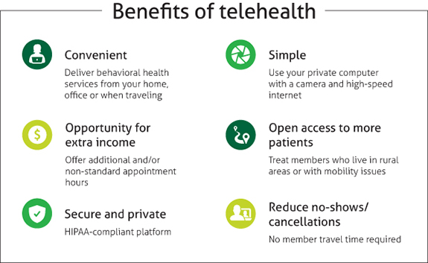

Slide 5

SCREESHOTS
THE GEMINI
TELEMEDICINE SYSTEM

Slide 6

PATIENT LOGIN

Slide 7
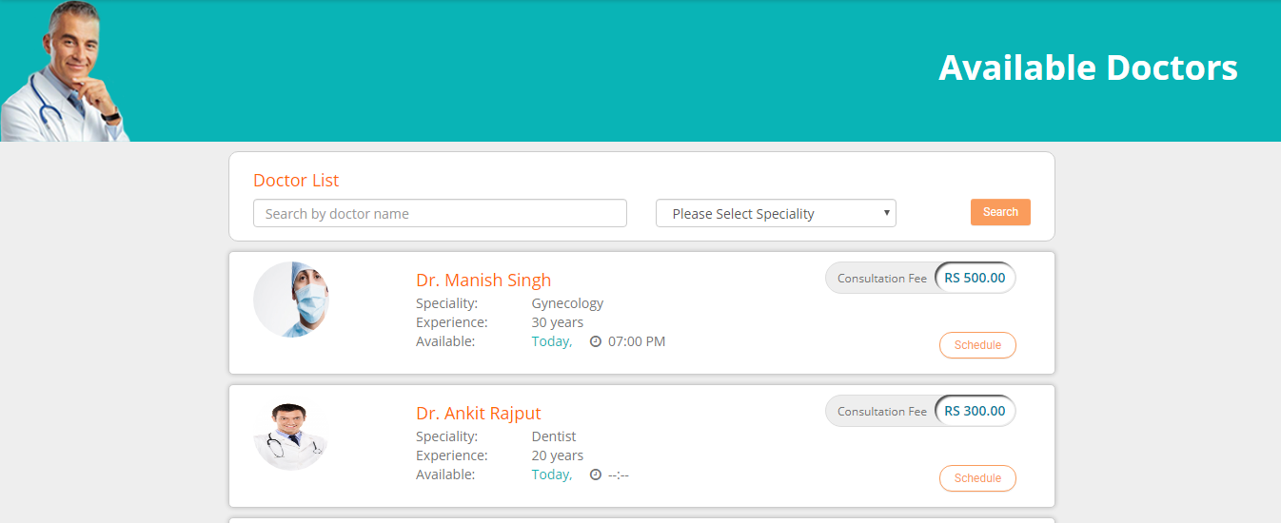
PATIENT CAN SEARCH FOR DOCTOR BY NAME OR SPECIALITY.

Slide 8
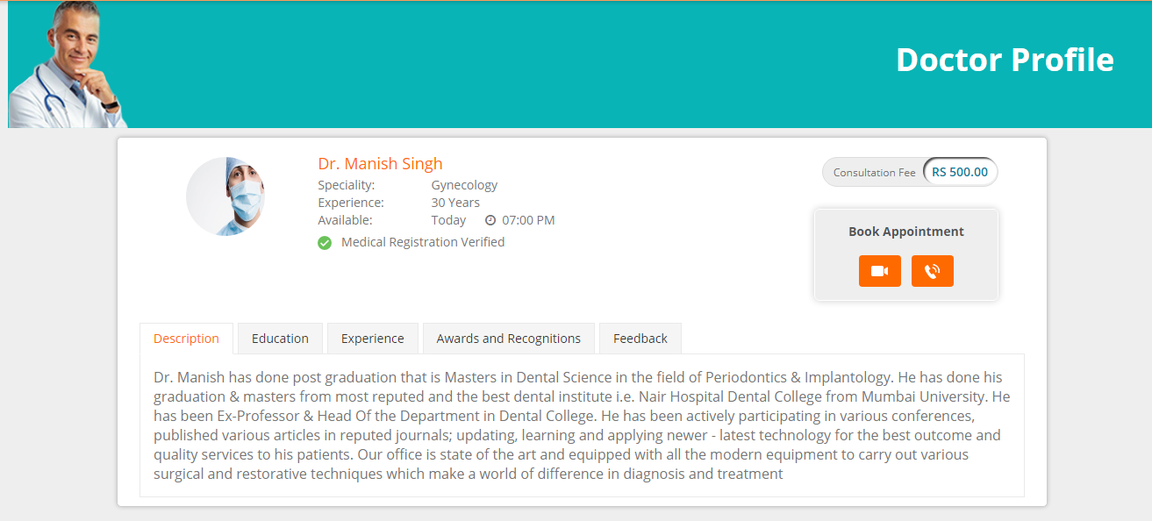
PATIENT CAN SEE DOCTOR PROFILE & CHOOSE MODE OF CONSULTATION ( AUDIO / VIDEO ).

Slide 9
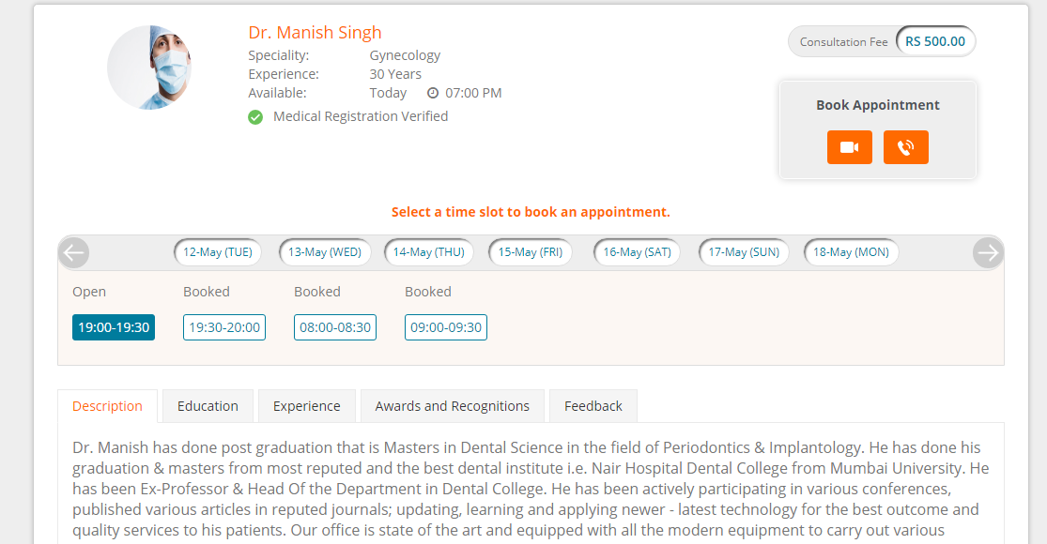
PATIENT CAN CHOOSE AVAILABLE DATE & SLOT FOR APPOINTMENT.

Slide 10
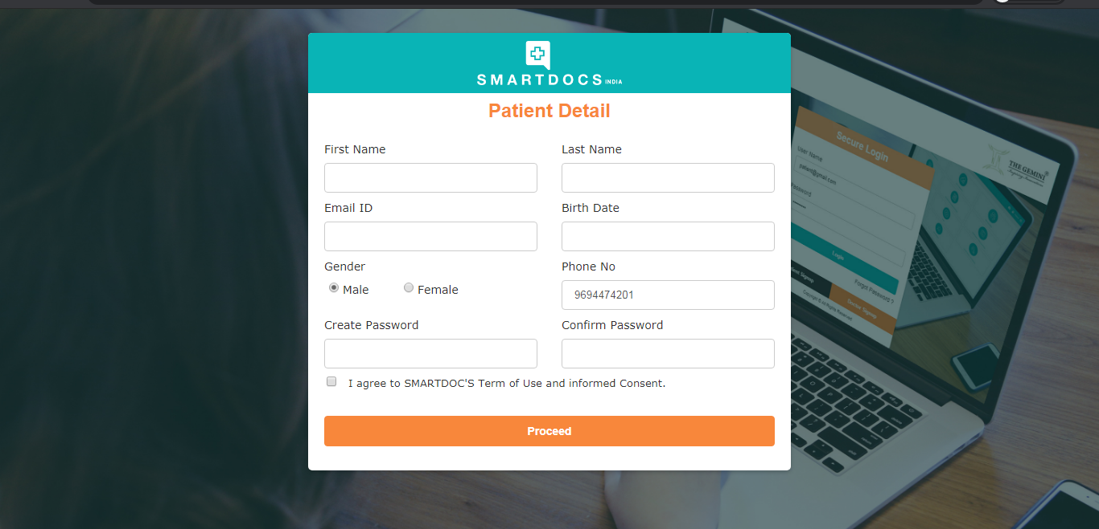
PATIENT CAN SIGN IN OR SIGN UP FOR FURTHER STEPS.

Slide 11
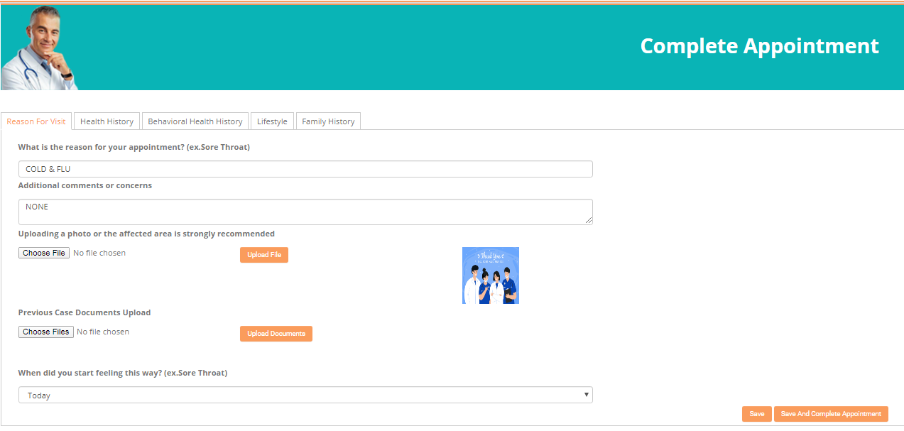
PATIENT CAN COMPLETE AN APPOINTMENT BY FILLING HIS HEALTH INFORMATION.

Slide 12
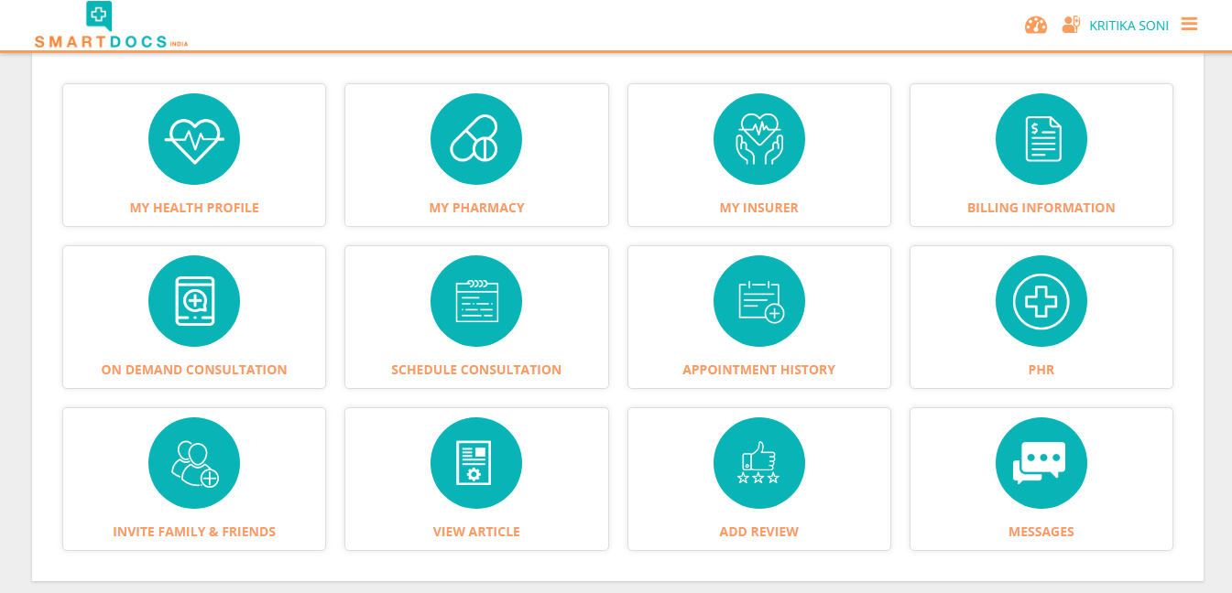
PATIENT DASHBOARD.

Slide 13
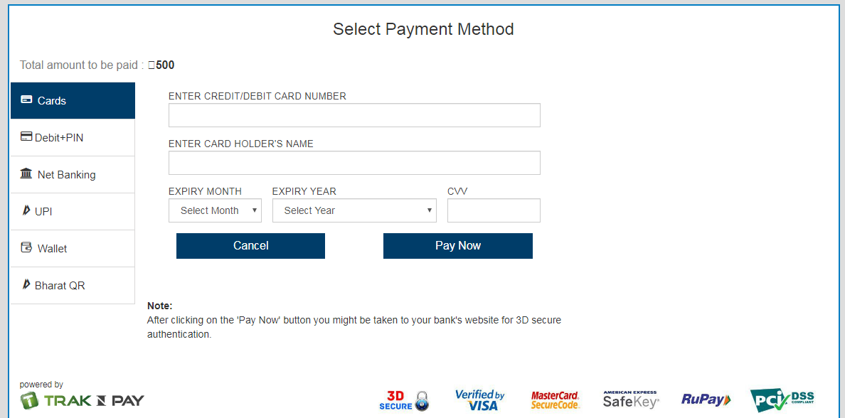
PAYMENT GATEWAY.

Slide 14
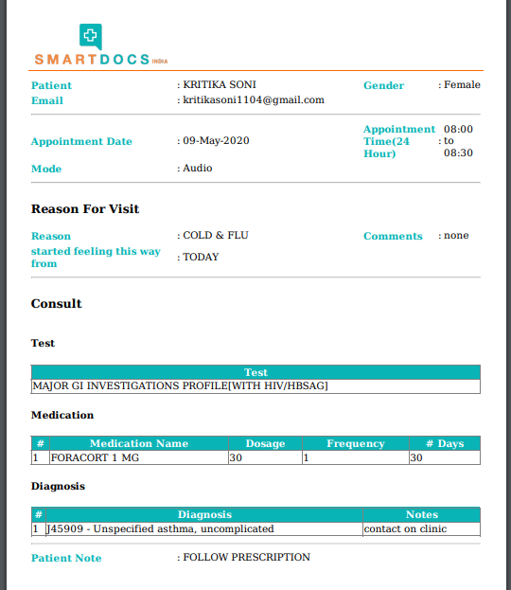
PATIENT CAN VIEW & PRINT PRESCRIPTION SENT BY DOCTOR.

Slide 15
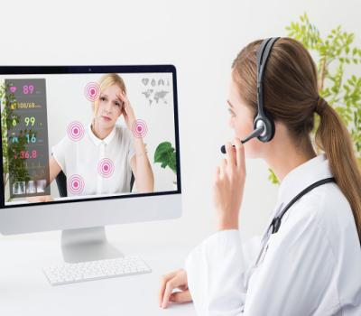
DOCTOR LOGIN

Slide 16
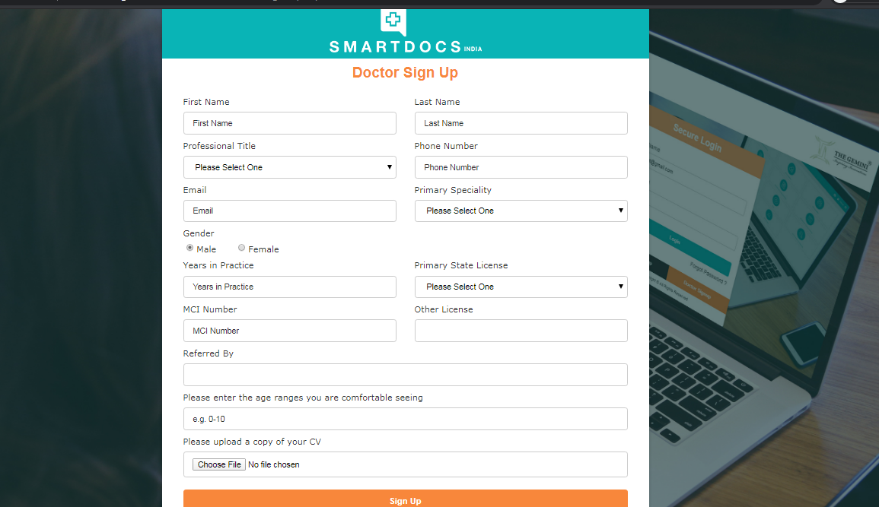
DOCTOR SIGN UP FORM.

Slide 17
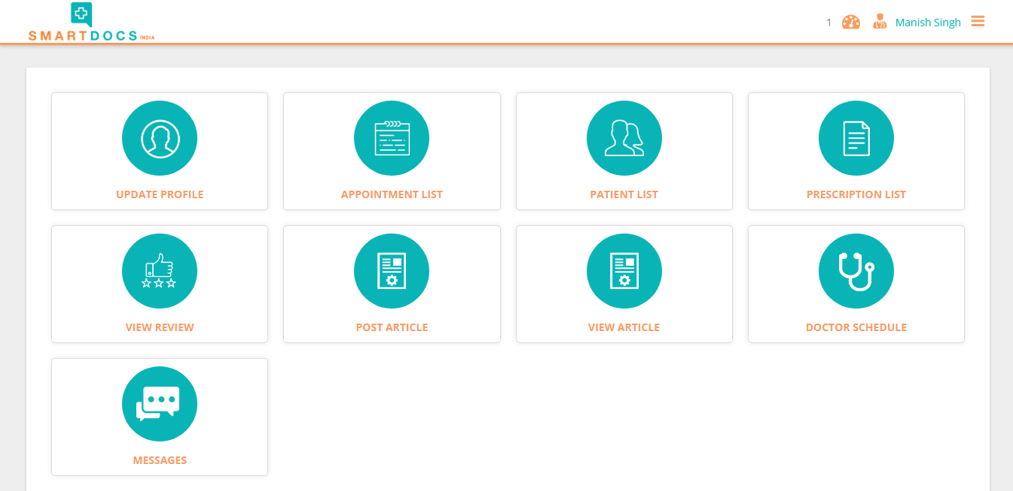
DOCTOR DASHBOARD.

Slide 18
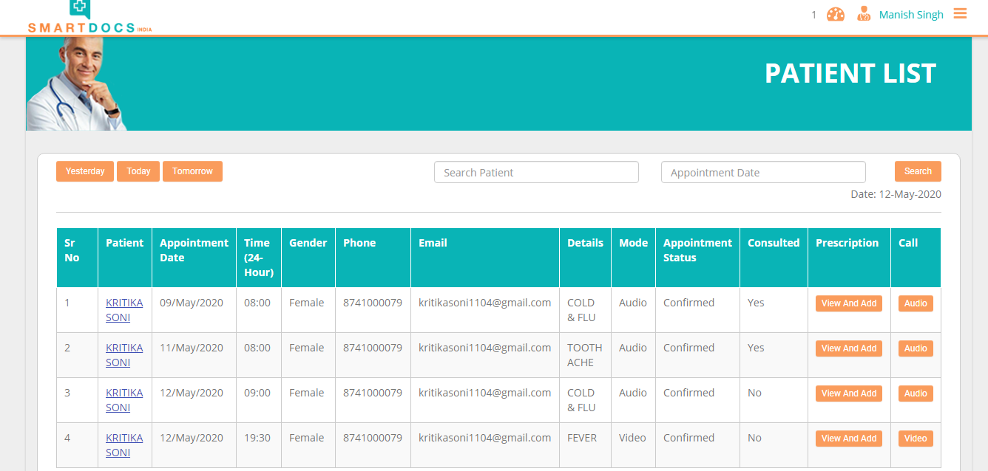
DOCTOR CAN VIEW PATIENT APPOINTMENT DETAILS & CAN CALL.

Slide 19
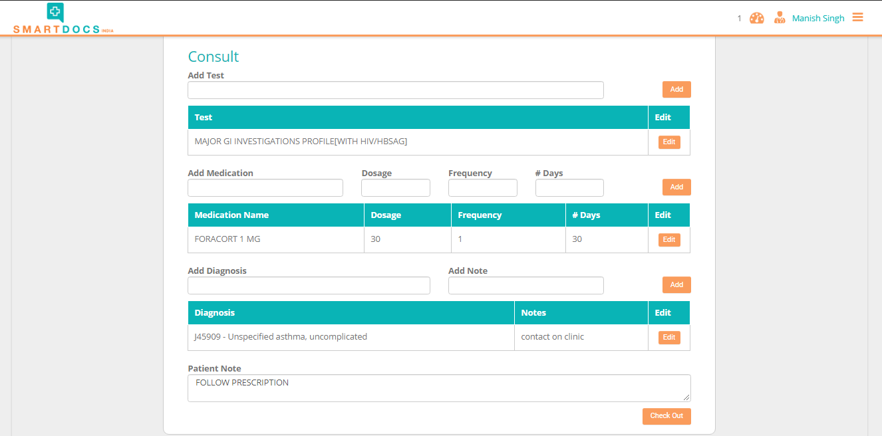
DOCTOR CAN WRITE PRSCRIPTION.

Slide 20
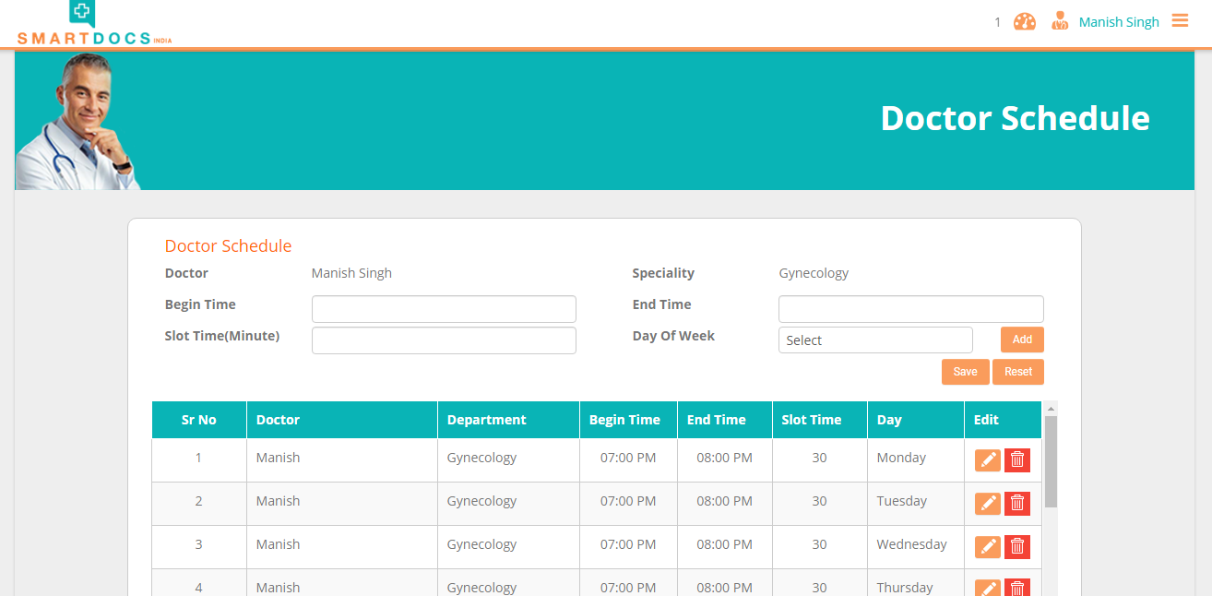
DOCTOR CAN MAKE HIS SCHEDULE.

Slide 21
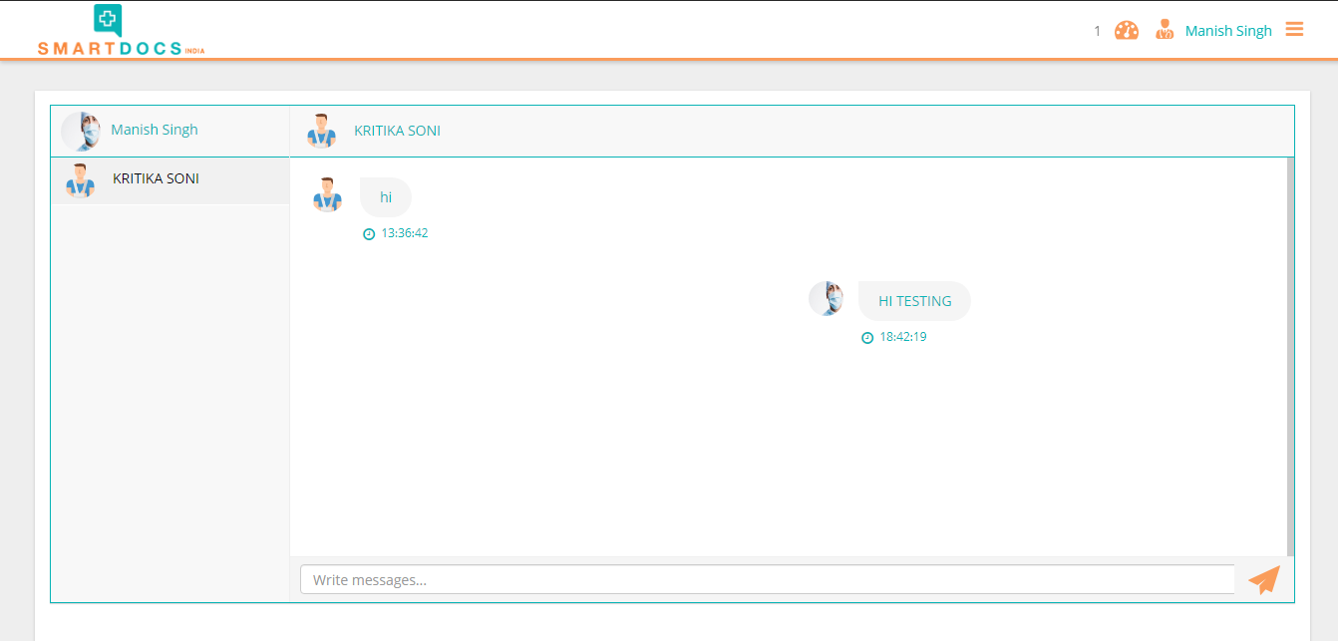
DOCTOR CAN SEND & VIEW MESSAGES.

Slide 22

ADMIN LOGIN

Slide 23
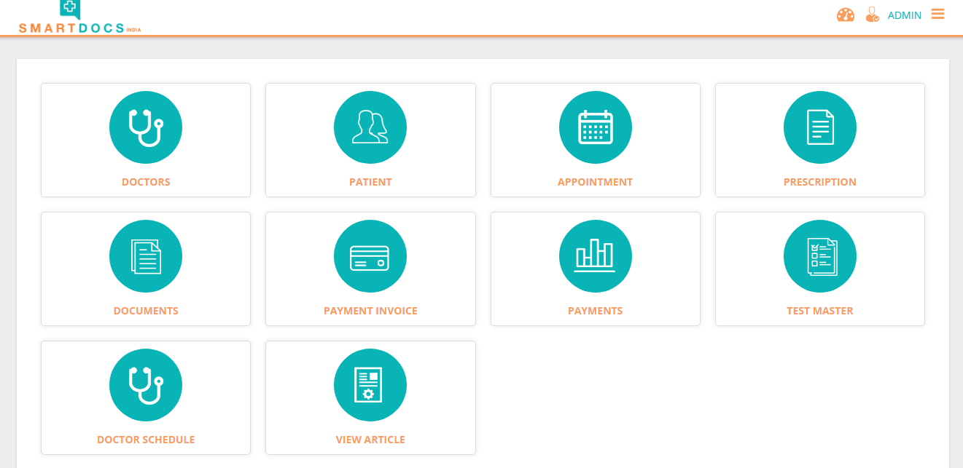
ADMIN DASHBOARD.

Slide 24
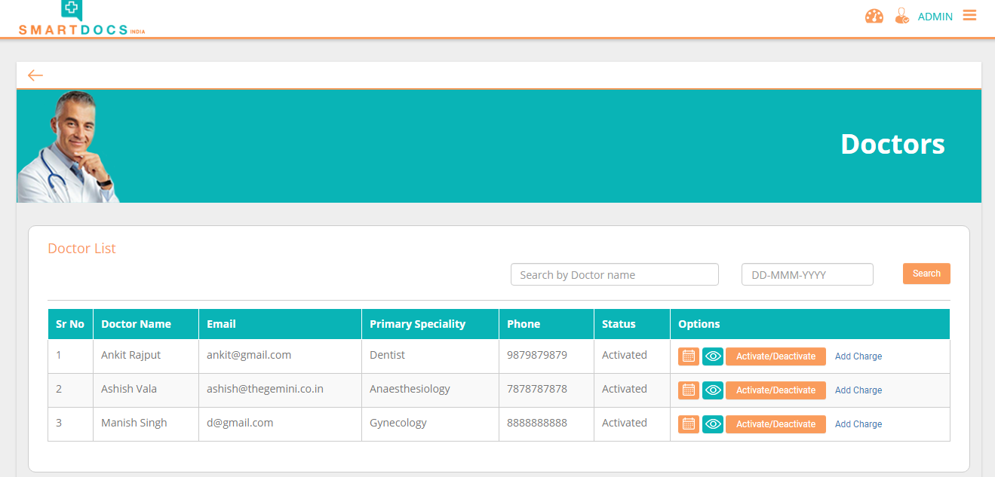
ADMIN CAN DOCTOR DETAILS.

Slide 25
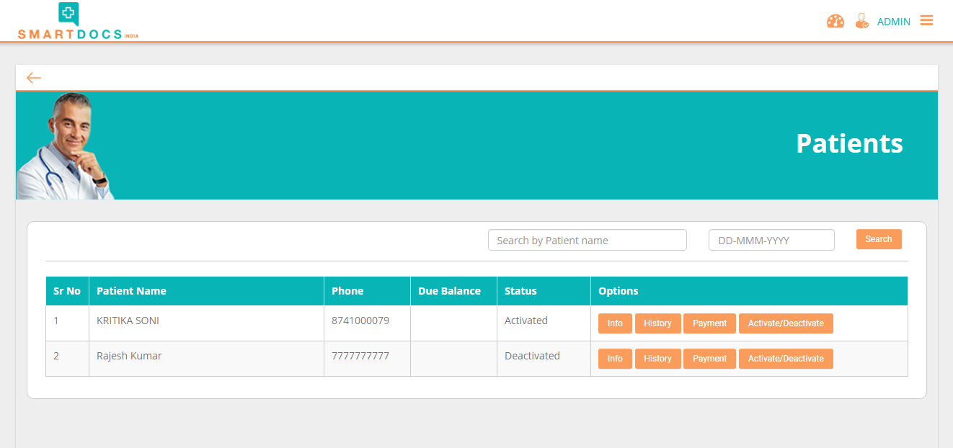
ADMIN CAN SEE PATIENT LISTS.

Slide 26
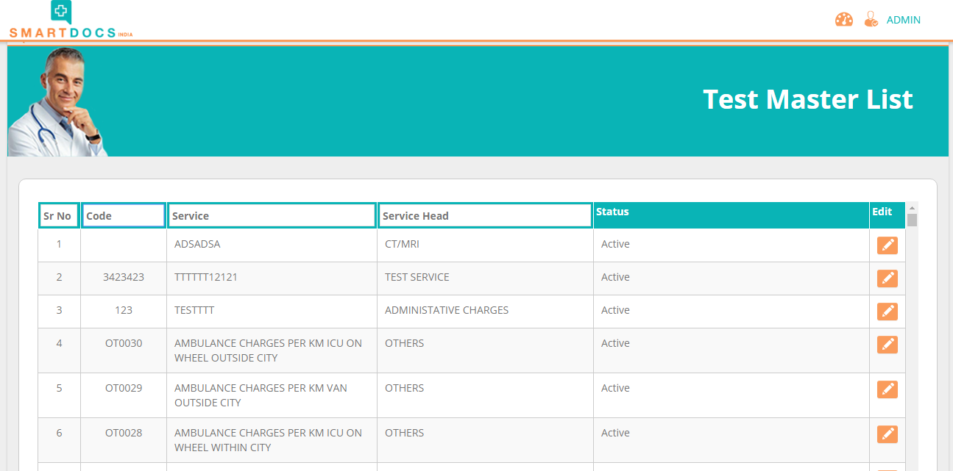
ADMIN CAN ENTER TEST MASTERS.

Slide 27

DEVELOPMENT CELL :
Ahmedabad, Ajmer, Kolkata
TECHNICAL SUPPORT :
Udaipur, Mumbai, Bangalore, Noida, Pune, Kolkata, Bhubaneswar
BUSINESS ADDRESS :
Berlin, Germany
THE GEMINI PARTNER :
Nigeria, Kenya, Uganda, UAE, Trinidad
OUR LOCATION
27

Slide 28

CONTACT US :
Call : +91 9265562676
Email: consultants@thegemini.co.in
Visit : www.thegemini.co.in

